Slide 1
Building chatbots with MS Bot Framework
Rock Paper Scissors

Slide 2
Copy the files from here
https://github.com/code-monster-kevin/chatbot-102/tree/rock-paper-scissors

Slide 3
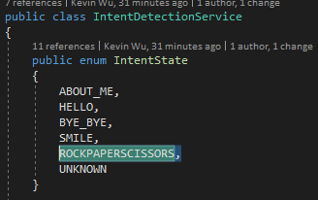
In IntentDetectionService, add a new “ROCKPAPERSCISSORS” in IntentState enum

Slide 4
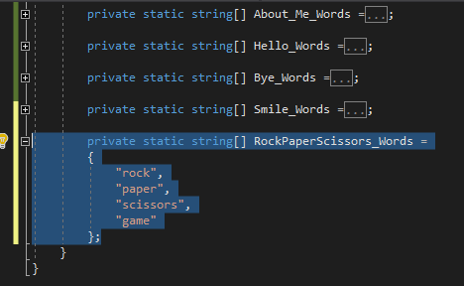
Add new static string[] RockPaperScissors_Words

Slide 5
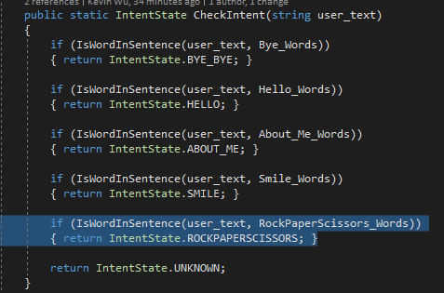
In the CheckIntent function, add code to detect RockPaperScissor words

Slide 6
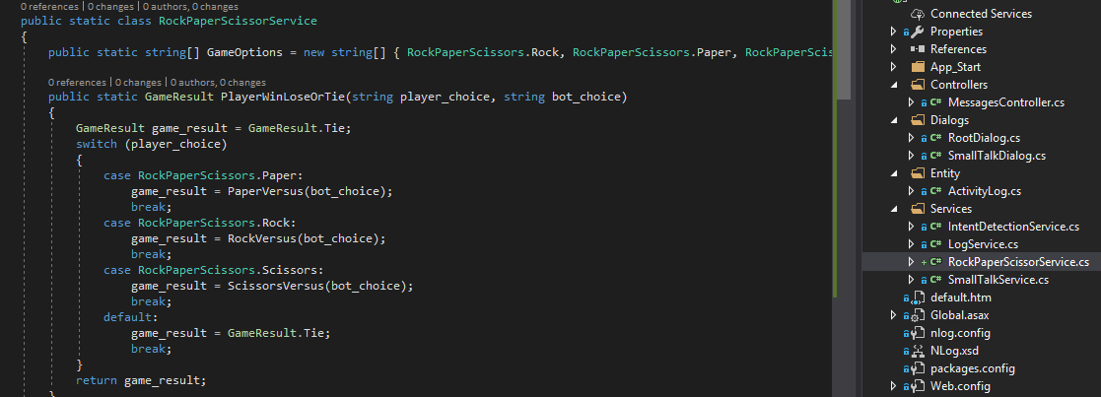
Under “Services” folder, add “RockPaperScissorService.cs” class

Slide 7
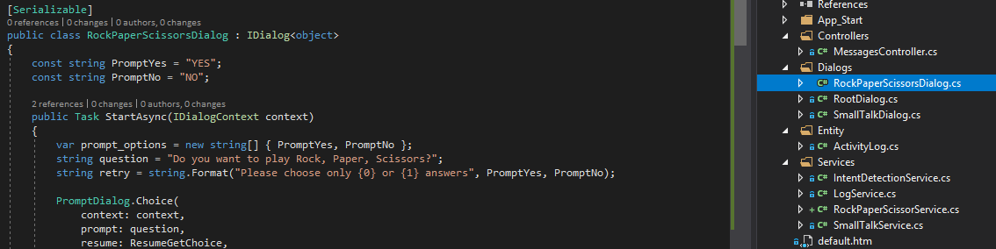
In “Dialogs” folder, add “RockPaperScissorsDialog.cs” class

Slide 8
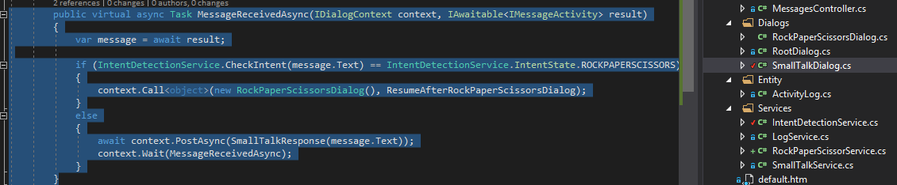
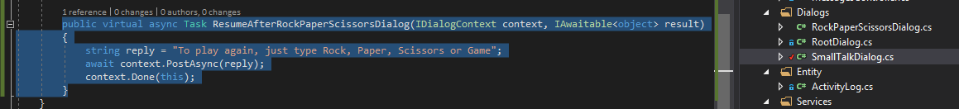
In SmallTalkDialog.cs, add code to detect RockPaperScissors intention and also to handle event after game is over

Slide 9
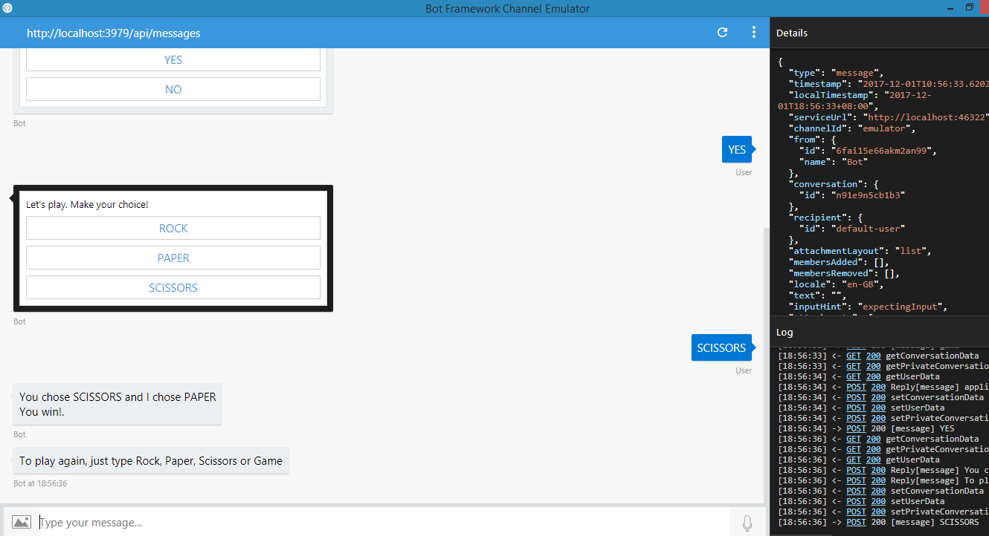
Run the application and play the game!

